Slide 1

NETFLIX Customer Rating Prediction with KNIME
Serdar MUTLU
Muhammed Emre SEVUK
Serap YALÇIN
BAN 504
04.01.2020

Slide 2

Agenda
Aim of the Project
Dataset
Modelling
Conclusion

Slide 3
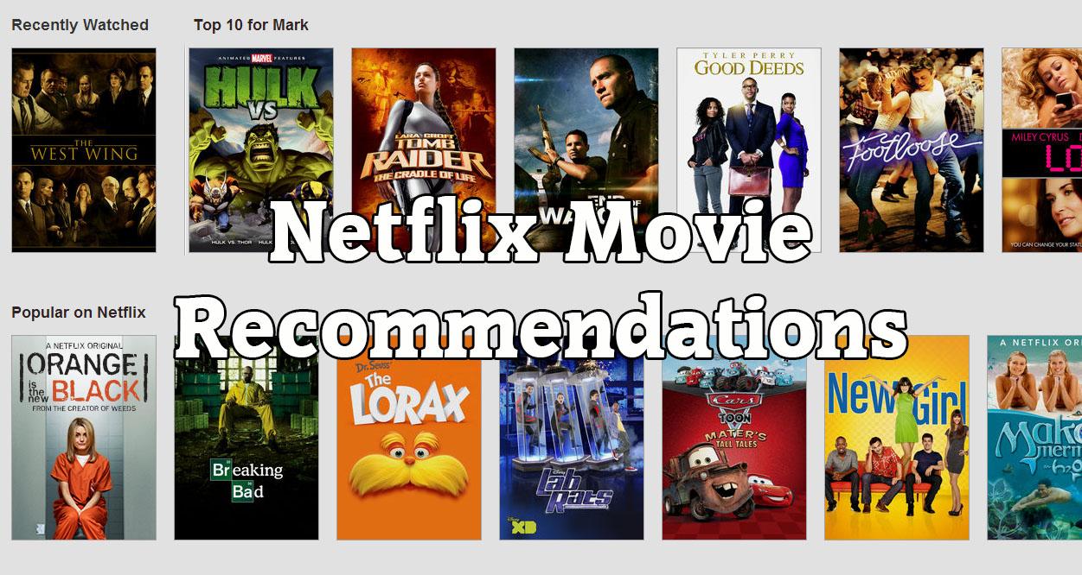
Aim of the Project : Prediction
  Predicting the customer ratings with KNIME
  Analyze the performance of different Machine Learning and Deep Learning models

Slide 4

Dataset: NETFLIX
Training Dataset
MovieIDs range from 1 to 17770
CustomerIDs range from 1 to 2649429
Ratings are on a five star
Dates in YYYY-MM-DD format
Movie File
MovieIDs
Year of Release in range from 1890 to 2005
Title is the Netflix movie title

Slide 5

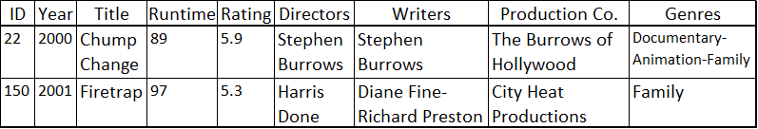
Building Dataset: IMDB

Slide 6
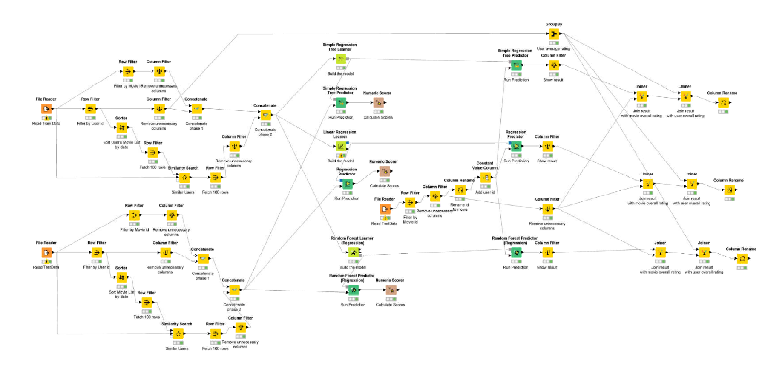
Data Reduction
No duplicated data and missing values
Second period of 2005 is used in the project
Training dataset covers 80% of data, and test data set covers 20% of data

Slide 7
Similarity Analysis
Similarity sets are created, and merged based on movie-users similarity, user-movie preferences, and user-users similarity
Movie-users similarity:
  Movie is watched by which users, and what are ratings?
User-movie preference:
  User has watched which movies, and what are the ratings? In other words, movie preferences of this specific user.
User-users similarity:
  Which users have same movie preferences as our specific user?

Slide 8
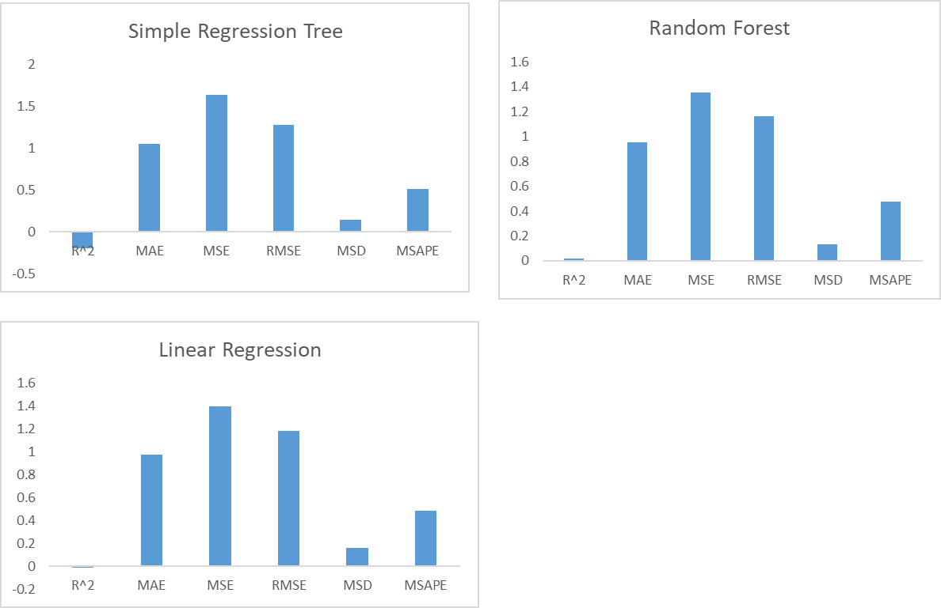
Modelling
Three algorithms were implemented
The data set is used for learning and the test part
Mean Absolute Error, Mean Square Error and Mean Absolute Performance Error are used as performance metrics

Slide 9
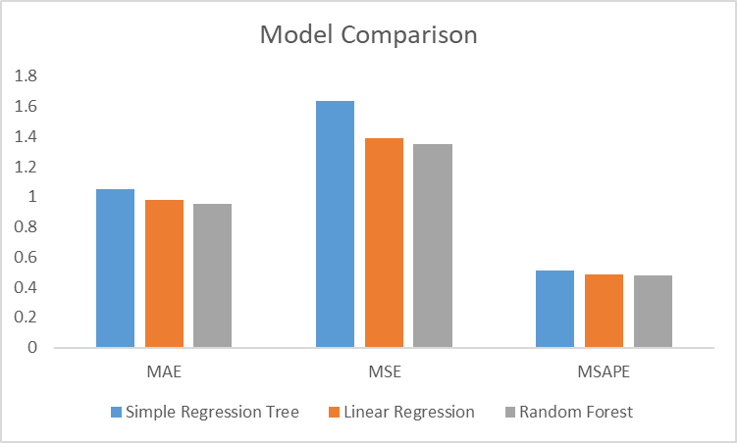
Conclusion
  The best model is Random Forest with lowest performance measures

Slide 10
Resources
“MS Windows NT kernel description.” https://help.netflix.com/tr/node/412. Accessed: 2019-12-28.
L. Feltrin, “Knime an open source solution for predictive analytics in the geosciences [software and data sets],” IEEE Geoscience and Remote Sensing Magazine, vol. 3, pp. 28–38, 12 2015.
C. Bancu, M. Dagadita, M. Dascalu, C. Dobre, S. Trausan-Matu, and A. M. Florea, “Arsys-article recommender system,” pp. 349–355, 09 2012.

Slide 11
Thanks

